Slide 1

Background
Aims
Lots of Covid prediction models
Not enough validation done and poor track record
Stokes, et al. (2022) found Arina et al. (2020) worked well in pre-dexamethasone patients (C=0.839) but poorly after (C=0.613)
No validations of models developed in ICUs
Are published ICU multivariable prediction models sufficiently described to allow new predictions to be generated, and performance compared to the original publication?
Do these models use parameters that are routinely recorded in most ICUs?
Is the performance (by discrimination and/or calibration) of these models replicable in patients from a similar period to when the model was developed, either pre- or post-the introduction of dexamethasone?
Is the performance (by discrimination and/or calibration) of these models replicable using patients for the duration of the pandemic?
References: github.com/sgbstats/NIHRstats23

Slide 2
Methods
Lit Search: Wynants (2020), PubMed, reverse citation
IC/EC: models where the study population used to develop the original model was
Adults (aged over 16 years) admitted to the ICU with a diagnosis of COVID pneumonitis
Required at least two predictor variables, and which were measured within 24 hours of, or prior to, ICU admission or 24 hours prior to onset of invasive mechanical ventilation (IMV), depending on the model, or demographic data.
The endpoint was death at any point, need for IMV, or length of stay in ICU.
Data extraction: assess whether predictions can be generated based off what was published; cross reference variables against what was available in the EPR
Those that qualify: remake the model using the IC/EC of the original publication; check discrimination using the same test that the original paper used and calibration (if possible).
Data: Manchester Royal Infirmary ICU EPR (1/3/20 to 28/2/22); incidental covid and national data opt-out excluded; ethical approval 21/HRA/3518

Slide 3
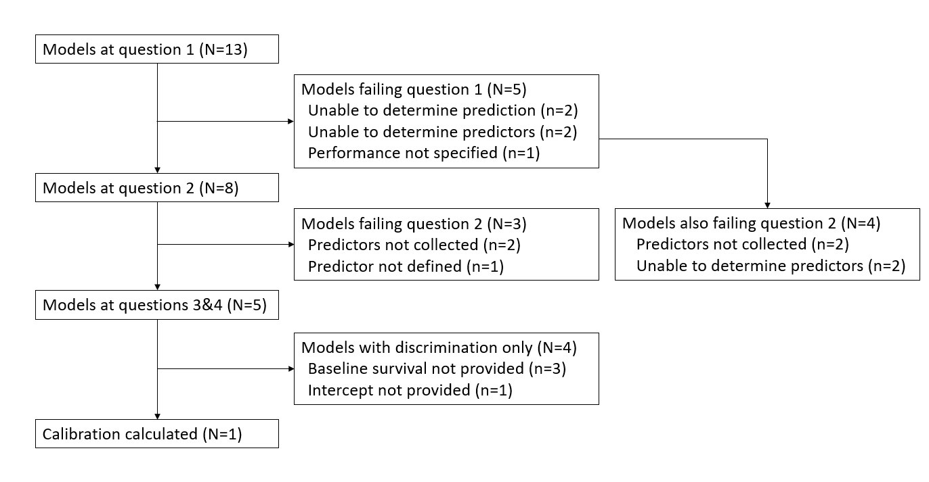
Results
Too many models can’t be validated, of those only one retained performance but still cannot be recommended for clinical use.
 | Model Type | Original publication |  | Pre-dexamethasone era |  | All patients
Reference |  | N | Reported C | N | C | N | C
Arina | Logistic regression | 93 | 0.804 (0.728 - 0.880) | 27 | 0.793 (0.618-0.968) | 103 | 0.596 (0.482-0.710)
Cao | Logistic regression | 77 | 0.857 (0.77–0.94) | 22 | 0.567 (0.321-0.813) | 141 | 0.558 (0.460-0.655)
Leoni, Lombardelli | Cox regression | 229 | 0.821 (0.766–0.876) | 33 | 0.605 (0.471-0.739) | 204 | 0.564 (0.506-0.622)
Leoni, Moschini | Cox regression | 98 | 0.720 (0.67-0.79) | 34 | 0.560 (0.428-0.692) | 201 | 0.546 (0.484-0.608)
Moisa | Cox regression | 425 | 0.697 (0.755–0.833) | 53 | 0.672 (0.574-0.770) | 291 | 0.686 (0.640-0.732)
Conclusion
On the basis of our findings, we urge bedside intensivists to exercise caution before using any of the examined models to support clinical decision making.
Don’t go round making prediction models because you are bored
Use TRIPOD to at least give us a fighting chance of being able to validate it

